Slide 1
Pixiesketch
Spring Capstone 2024

Slide 2
Overview
This project is children centric, which means the user-interface and features and functions in the application are child friendly.
The application is allows the user to transform any colored drawing image into an empty sketch to let the colorful waves flow.
This is basically a sandbox for growing artists.

Slide 3
Features we offer
BASIC FEATURES
Image Upload and Processing
Pencil Sketch Conversion
Simple UI/UX
Voice Commands (Basic)
ADVANCE FEATURES
Advanced Image Editing
Voice Command Integration

Slide 4
Flow Chart
Colored Image
Converting from RGB to Grayscale
Inverting the image
Final Pencil Sketch!!!
Using GaussianBlur

Slide 5
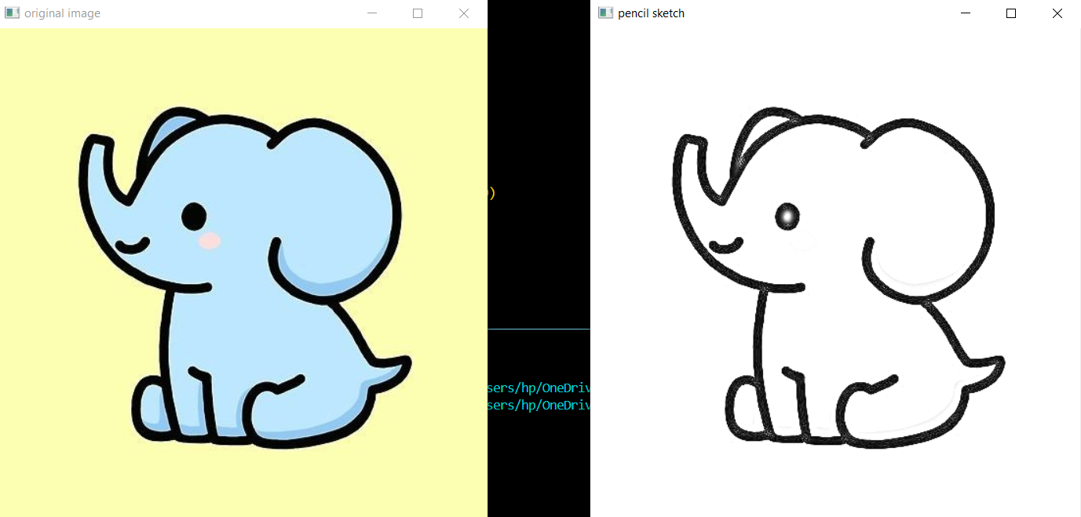
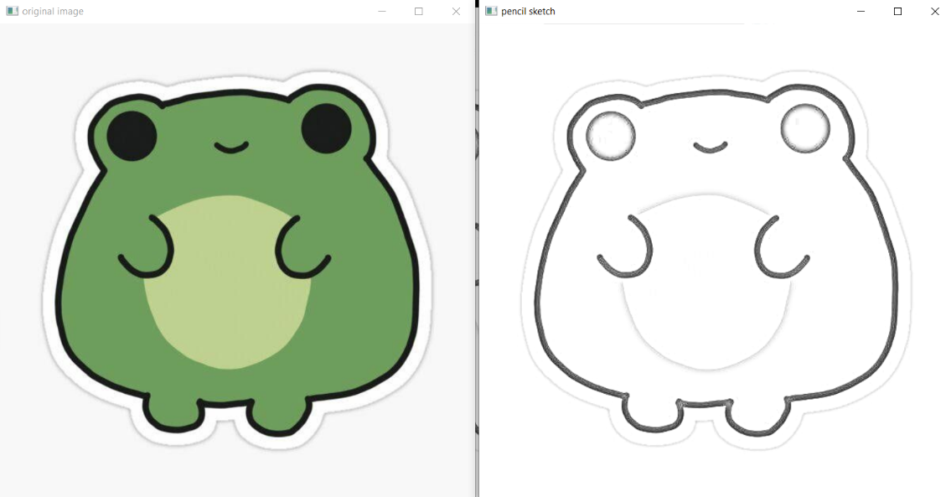
End Goal
Our teams end goal is to provide smooth interface with visually appealing functions.

